Slide 1
Parts of Speech Activity Kit: Brian Cleary Books and Game Board
Sarah Stoltz and Sydney Arman

Slide 2
Standard
1.L.1 Demonstrate command of the conventions of standard English grammar and usage when writing or speaking.
b. Use common, proper, and possessive nouns.
d. Use personal, possessive, and indefinite pronouns (e.g., I, me, my; they, them, their, anyone, everything).
e. Use verbs to convey a sense of past, present, and future (e.g., Yesterday I walked home; Today I walk home; Tomorrow I will walk home)
f. Use frequently occurring adjectives.*
g. Use frequently occurring conjunctions (e.g., and, but, or, so, because)

Slide 3
Board Game

Slide 4
Instructional Methods
We will read a Brian Cleary book to them for every lesson except the last day, followed by reflective questions about the reading
Then we will go over the part of speech and leave examples on the Smart Board for them to use as a guide during the game
During lesson we will use formative assessment such as thumbs up/down, talk to elbow partner, and exit slips
For every day of this lesson the students will play board game in groups of 4
Split class into groups with high flyers and low flyers to help with differentiation

Slide 5
Lesson Plans

Slide 6
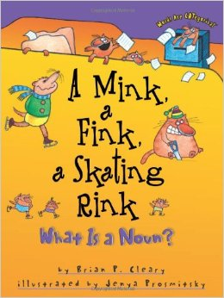
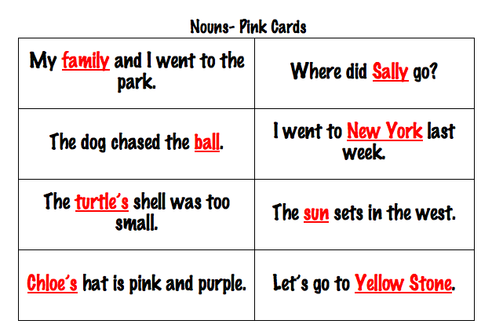
Day 1: Nouns 1.L.1 b
Common, proper, and possessive
Read Brian Cleary’s book: A Mink, a Fink, a Skating Rink: What is a Noun? To begin the lesson
Play board game with pink noun cards (20 cards per group)

Slide 7
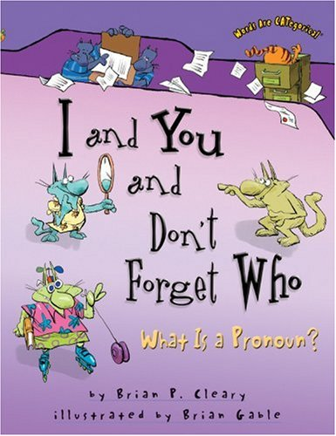
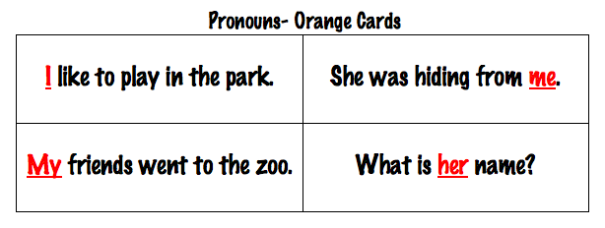
Day 2: Pronouns 1.L.1 d
Personal, possessive and indefinite
Read Brian Cleary’s book: I and You, and Don’t Forget Who: What is a Pronoun? To begin the lesson
Play board game with orange pronoun cards (20 cards per group)

Slide 8
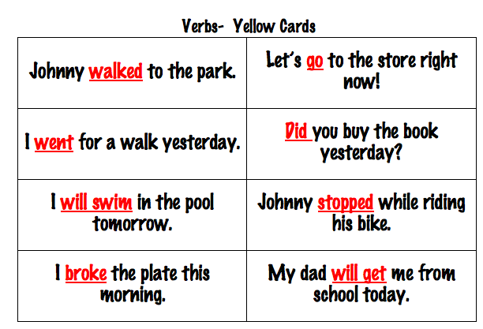
Day 3: Verbs 1.L.1 e
Tenses: Past, Present, and Future
Read Brian Cleary’s book: To Root, to Toot, Parachute: What Is a Verb? To begin lesson
Play board game using yellow verb cards (20 cards per group)

Slide 9
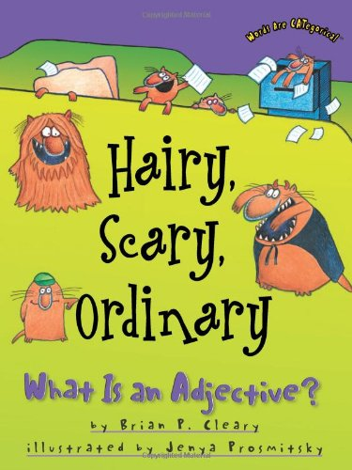
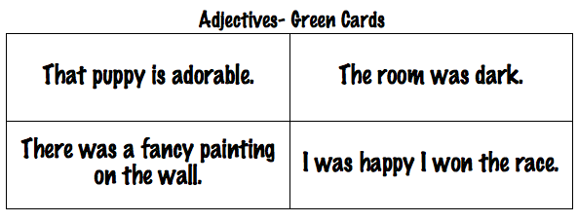
Day 4: Adjectives 1.L.1 f
Teach frequently occurring adjectives
Read Brian Cleary’s book: Hairy, Scary, Ordinary: What Is an Adjective? To begin the lesson
Play the board game using the green adjective cards (20 cards per group)

Slide 10
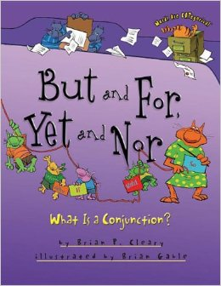
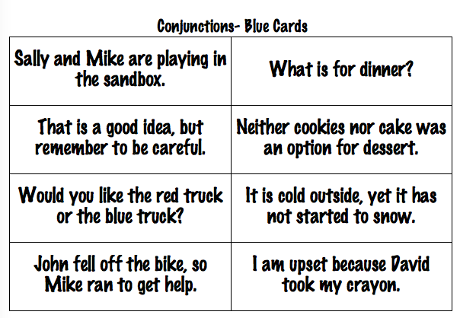
Day 5: Conjunctions 1.L.1 f
Teach frequently occurring conjunctions
Read Brian Cleary’s book: But and For, Yet and Nor: What Is a Conjunction? To begin the lesson
Play board game using the blue conjunction cards (20 cards per group)

Slide 11
Day 6: Review Day Lesson
Begin lesson with YouTube Video as overview of the parts of speech
Review each part of speech by playing the board game with all of the parts of speech (20 cards per color with all 5 colored cards)
What color the student’s pawn lands on is the colored card they pick up
Complete Summative Assessment worksheet

Slide 12
Materials

Slide 13
Board Game

Slide 14
Spread sheet
Students will enjoy listening to the Brian Cleary books because of his silly words. The game board activity includes silly sentences and a great opportunity for students to interact with peers.

Slide 15
